Slide 1
An Agent-Based Model of a Dynamic Mobile Ad-Hoc Network
ECE 508
Wesley Folz

Slide 2
Agenda
Background
Agent-Based Model
Experiments
Results
Demo
Future Work
Quiz

Slide 3
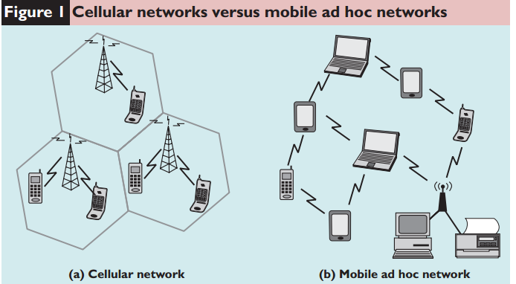
Mobile Ad-Hoc Networks
No Infrastructure
No Centralized Control
Dynamic Topology
Each can node act as a router
Primarily used in:
Military Battlefield
Sensor Networks
Disaster Areas
Personal Area Networks
Future uses:
Internet of Things
Vehicular Networks
Etc.
(Bakshi, et. al. 2013)

Slide 4
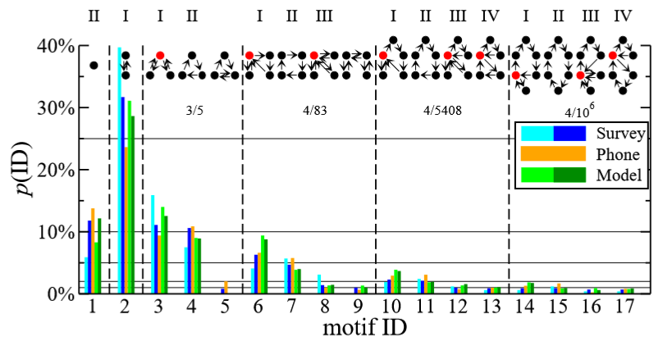
Daily Human Mobility Patterns
Human mobility can be characterized by a sequence of visited locations and trips between them (motifs)
Cell phone and survey data
About 90% of people visit less than seven locations per day
That 90% can be split into 17 different motifs
(Schneider et. al. 2013)

Slide 5
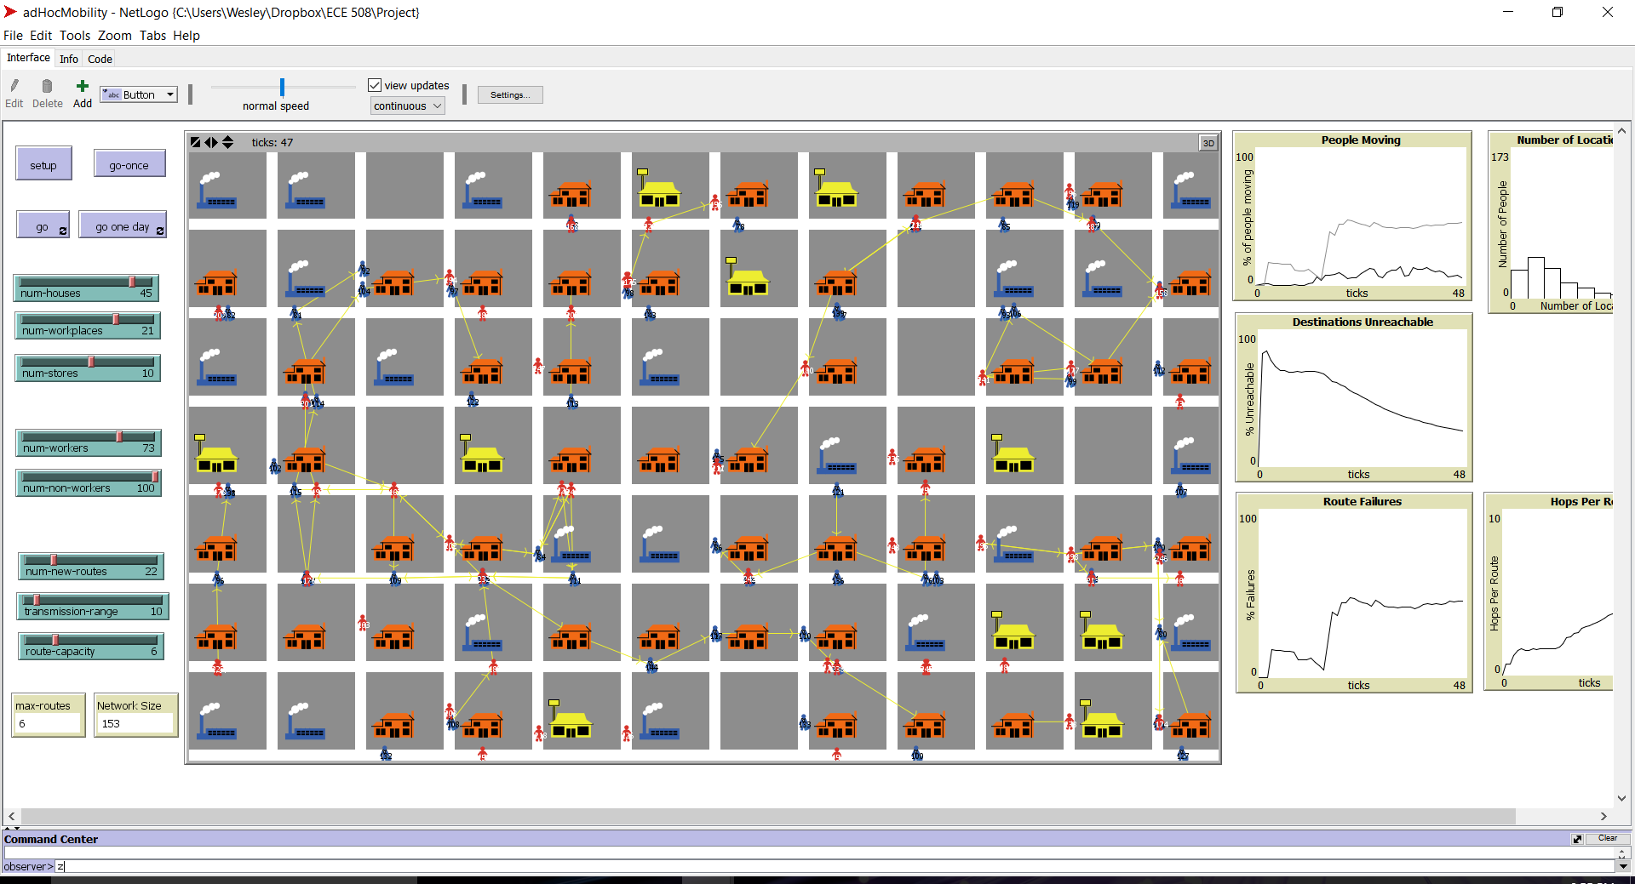
Agent-Based Model
Three types of Locations:
Houses
Workplaces
Stores (other locations)
Two types of agents:
workers
non-workers
Day is split into 48, 30 min time intervals
Each tick represents 1, 30 min time interval

Slide 6
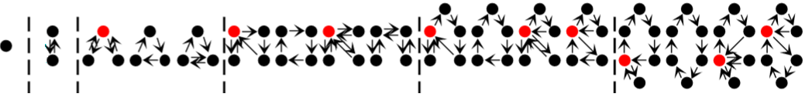
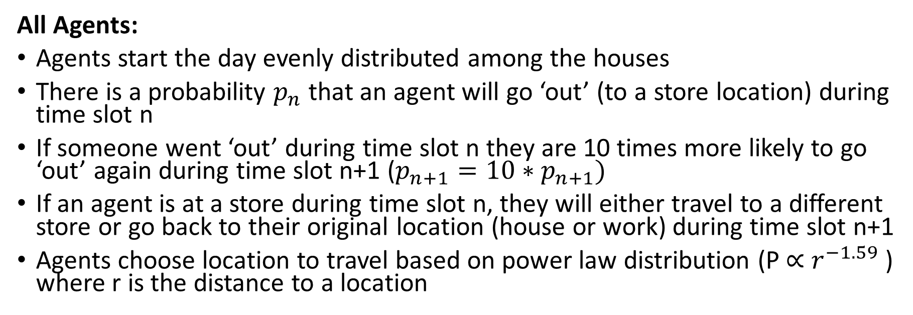
Human Mobility Model
All Agents:
Agents start the day evenly distributed among the houses
There is a probability $p_{n}$ that an agent will go ‘out’ (to a store location) during time slot n
If someone went ‘out’ during time slot n they are 10 times more likely to go ‘out’ again during time slot n+1 ($p_{n+1}=10∗p_{n+1})$
If an agent is at a store during time slot n, they will either travel to a different store or go back to their original location (house or work) during time slot n+1
Agents choose location to travel based on power law distribution ($\text{P}\text{ ∝ }r^{−1.59} \text{)}$ where r is the distance to a location
(Schneider et. al. 2013)

Slide 7
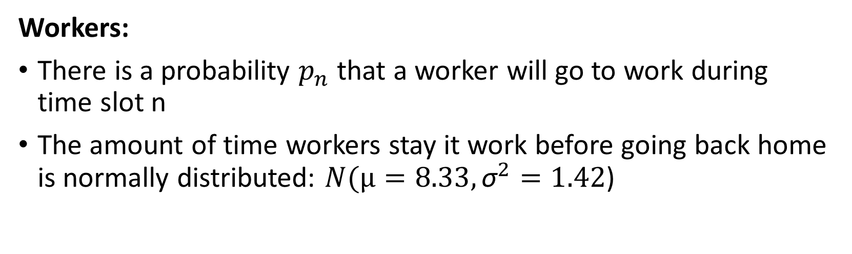
Human Mobility Model
Workers:
There is a probability $p_{n}$ that a worker will go to work during time slot n
The amount of time workers stay it work before going back home is normally distributed: $N(µ=8.33, {\text{σ}}^{2}=1.42$)

Slide 8
Smart Phone Ad-Hoc Network
Each agent is assumed to have a device (smart phone) connected to the Ad-Hoc Network
Every tick new random sources and destinations are created
Nodes in the network can transmit to other nodes within transmission range
Breadth first search to find route from source to destination with least number of hops
If a node has more routes going through it than the route capacity it dies (gets disconnected from the network)

Slide 9
Experimentation
Data Gathered
People Moving
The percentage of people moving during a given time slot
Route Failures
A route fails if a node in the route dies or moves out of transmission range with its neighbor
Hops Per Route
The average number of nodes between a source and destination
Destinations Unreachable
If a route does not exist between the source and destination
Max Routes
The max number of routes going through a single node
Experiments
Varied number of houses
Varied number of people
Workers
Non-workers
Looked at correlations between people movement and:
Route Failures
Hops Per Route
Destinations Unreachable
Max Routes

Slide 10
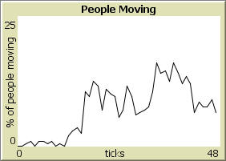
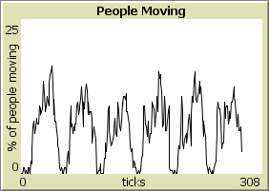
Emergent Results

Slide 11
DEMO

Slide 12
Future Work
More realistic geography
Increase scale
Run on network simulator to get accurate routing data
ns3
Use daily mobility model in other applications
Vehicular networks
Epidemiology
Etc.

Slide 13

Quiz
Generally people travel between less than ___ locations per day.
The distance that people travel between locations follows what type of probability distribution?
True or False: A lot of infrastructure is required to set up a mobile ad-hoc network?
7
Power law ($\text{P}\text{ ∝ }r^{−1.59} \text{)}$
False

Slide 14
References
Bakshi A., Sharma A.K., and Mishra A. “Significance of mobile ad-hoc networks (MANETS)” International Journal of Innovative Technology and Exploring Engineering (IJITEE) ISSN: 2278-3075, Volume-2, Issue-4, March 2013
Bhat, C. R. 2001 “Modeling the commute activity-travel pattern of workers: Formulation and empirical analysis.” Transp. Sci. , 35 (1), 61-79
Brockmann, D., Hufnagel, L. and Geisel, T. 2006 “The scaling laws of human travel” Nature 439, 462-465. (DOI 10.1038/nature04292
Hoebeke J., Moerman I., Dhoedt B., and Demeester P. “An overview of mobile ad hoc networks: applications and challenges.” J-Commun Netw 2004;3(3):60–6.
Schneider, C. M., V. Belik, T. Couronne, Z. Smoreda, and M. C. Gonzalez. “Unravelling Daily Human Mobility Motifs.” Journal of The Royal Society Interface 10, no. 84 (April 24, 2013): 20130246–20130246

Slide 15
Questions?

